Slide 1
Music Style Transfer With Pretrained Convolutional Neural Networks
JiaYi Wang, NanXian Li, JiaYing He
12-746 Sensing and Data Mining for
Smart Structures and Systems
Tuesday, May 1, 2018

Slide 2

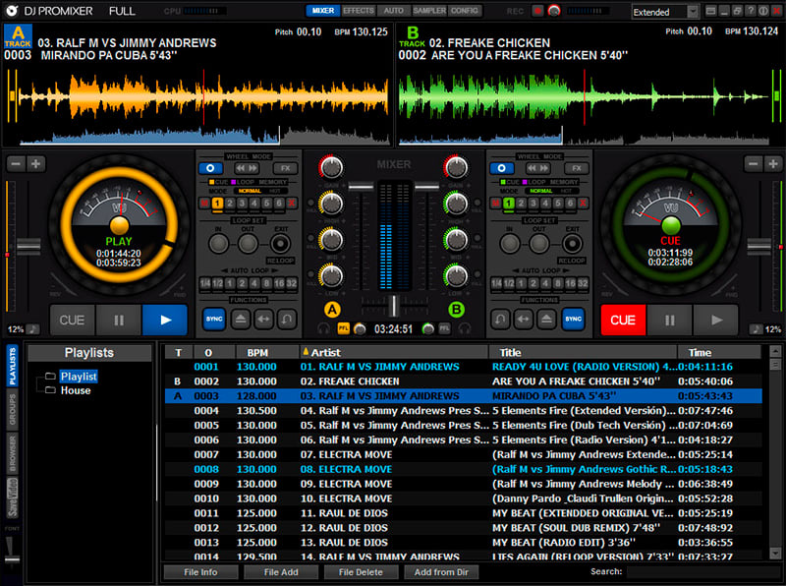

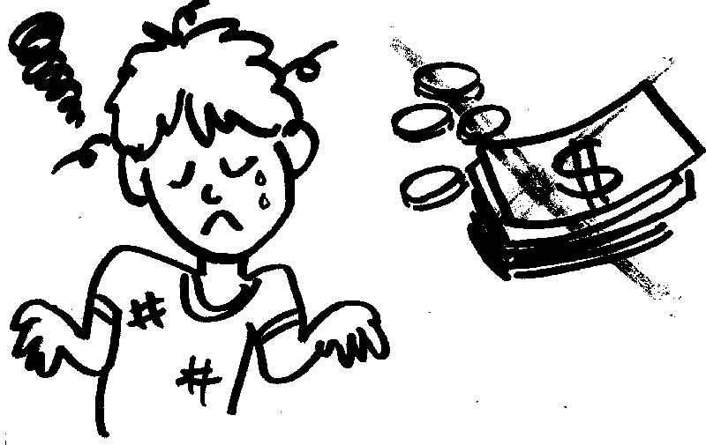
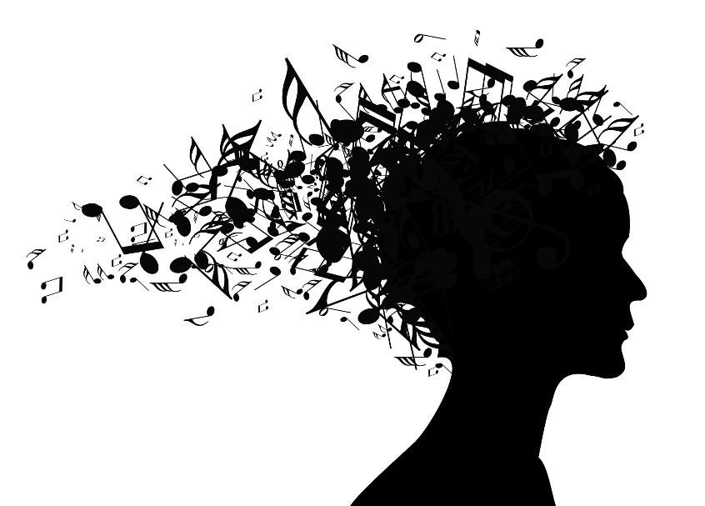

Problem & motivation
Existent song remixing is highly professional and time-consuming
Software: Requires that the user has music background

Slide 3
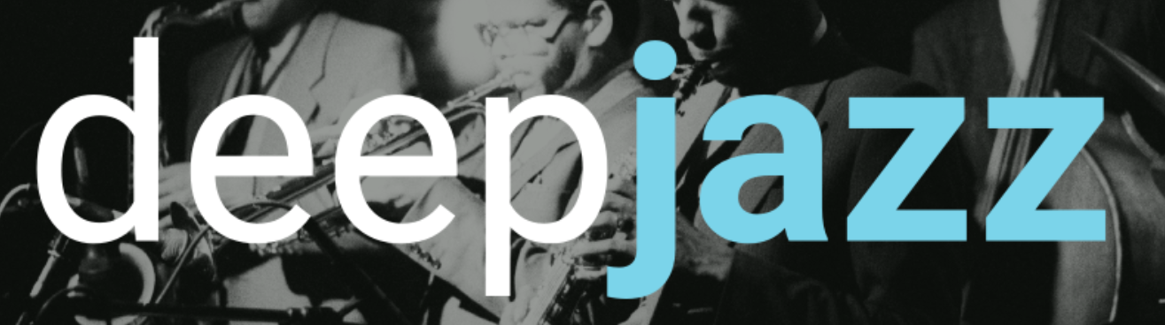

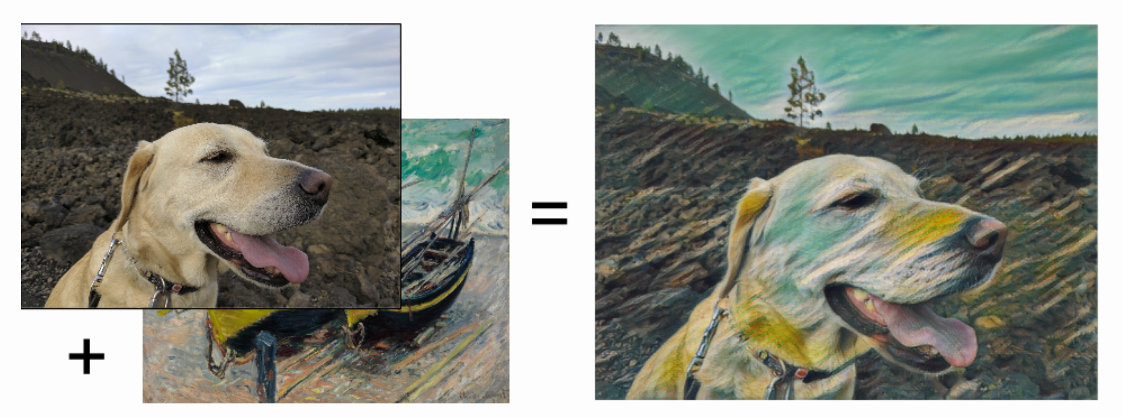

Literature review
Single layer music, for example, piano only. (2 layer LSTM)
Created first AI song
Still need professional musician

Slide 4
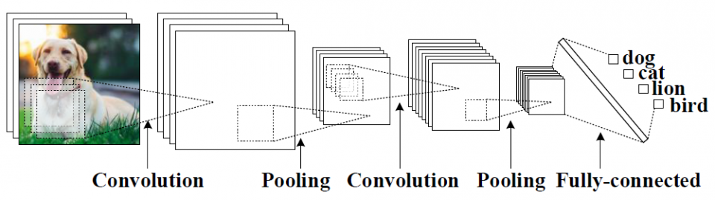
Style Transfer is a technique used to transfer a style of one picture to another.
Convolutional Neural Network

Slide 5
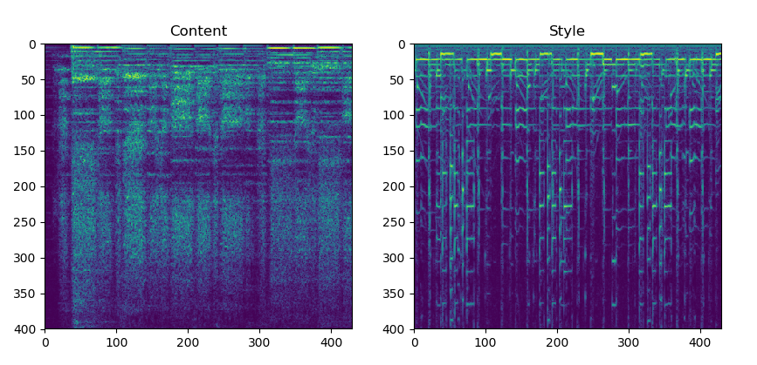

Innovation

Slide 6
Challenges
Training a deep learning network takes weeks even on GPUs
Convert the spectrogram back to audio file
Denoise

Slide 7


Solution: pre-trained convolutional neural network
Advantages:
- Spare training time
- Model already recognizes features
Models of choice:
VGG
VGGish
Notes:
Vgg is for image
Vggish for audio

Slide 8
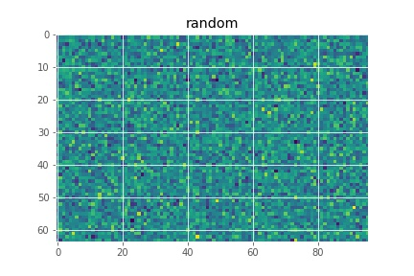
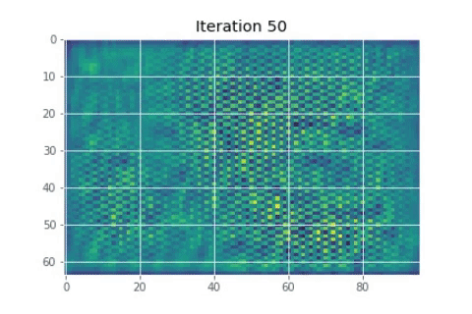
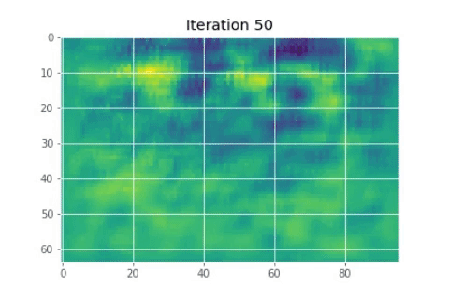
Transferring process with VGGish
Content Weight: 1.5
Style Weight: 10
Content Weight: 10
Style Weight: 1.5
Content Layer: 5th RELU
Style Layer: 1st RELU
Cannot convert back!

Slide 9
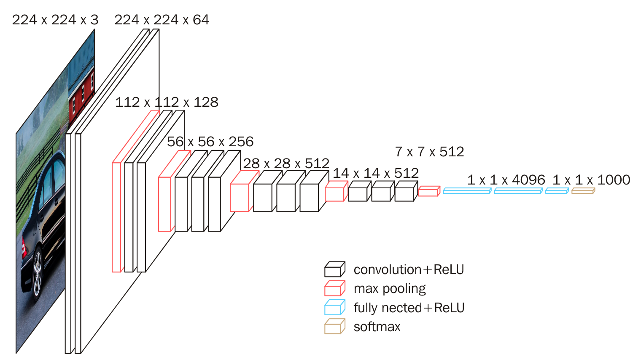
Music Style Transfer With VGG16 network
VGG16 – A high-accuracy, very deep convolutional neural network for image classification
Figure 1. Architecture of VGG-16 Convolutional neural network

Slide 10
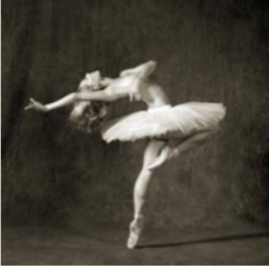
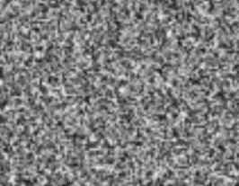
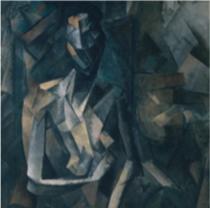
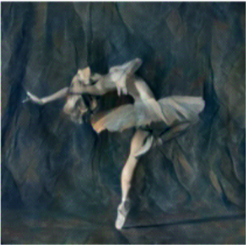
Model overview
sensing
Content feature 1
Content feature 2
Style feature 2
Style feature 1
VGG16 as
feature extractor
Content
Loss
Style
Loss
Total Loss
update
Optimizer

Slide 11

Sensing
Phone microphone: sampling rate 44100 Hz
Back

Slide 12
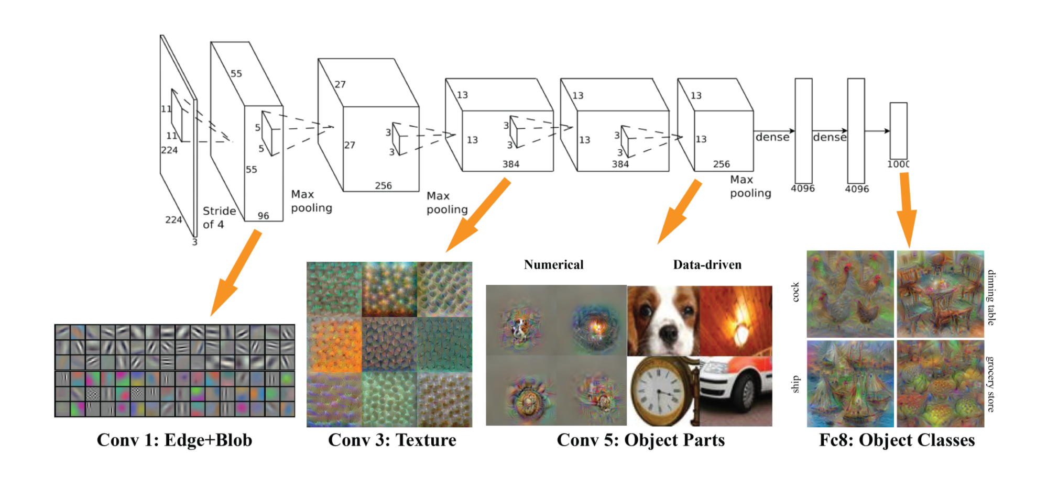
How feature extractor works
Figure 2. AlexNet / VGG-F network visualized by mNeuron.
Notes:
You may be wondering why we use the outputs of intermediate layers of a pretrained image classification network to compute our style and content losses. This is because, for a network to be able to do image classification, it has to understand the image. So, between taking the image as input and outputting its guess at what it is, it’s doing transformations to turn the image pixels into an internal understanding of the content of the image.

Slide 13
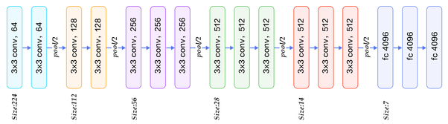
Feature: style and content
Style layer: All 13 convolutional layers
Content layer: 5th convolutional layer
Figure 3. Layer structure of VGG-16 network
Back

Slide 14
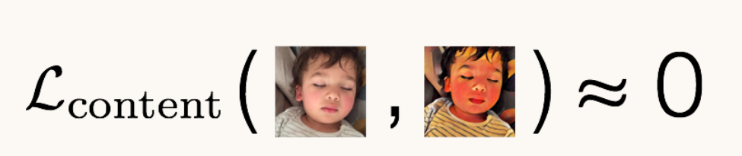
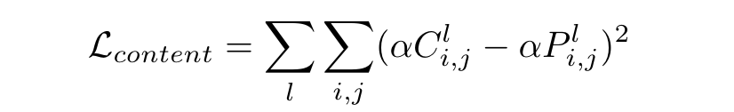
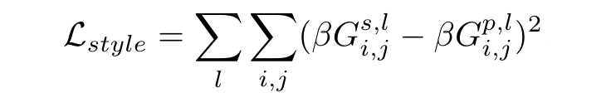
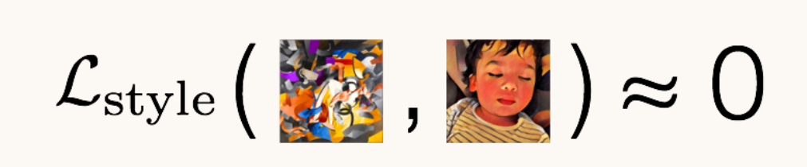
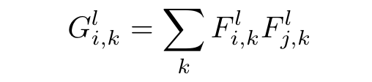
Loss function
Content loss:
Style loss:
Notes:
Content loss: measuring how different in content two images are from one another.
Style loss: how close in style two images are to one another
A Gram matrix results from multiplying a matrix with the transpose of itself
We can interpret these internal understandings as intermediate semantic representations of the initial image and use those representations to “compare” the content of two images. As an example: if we pass two images of cats through an image classification network, even if the initial images look very different, after being passed through many internal layers, their representations will be very close in raw value. This is the content loss — pass both the pastiche image and the content image through some layers of an image classification network and find the Euclidean distance between the intermediate representations of those images.

Slide 15
Loss function
Total loss = content weight * adjust content * content loss +
style weight * adjust style * style loss +
denoise weight * adjust denoise * denoise loss
pre-defined updated in each iteration
Gradient descent → minimize total loss
Back
Notes:
weight_content=1.5,
weight_style=10.0,
weight_denoise=0.3
Content loss is the sum of content loss of each content layer
Style loss is the sum of style loss of each style layer

Slide 16
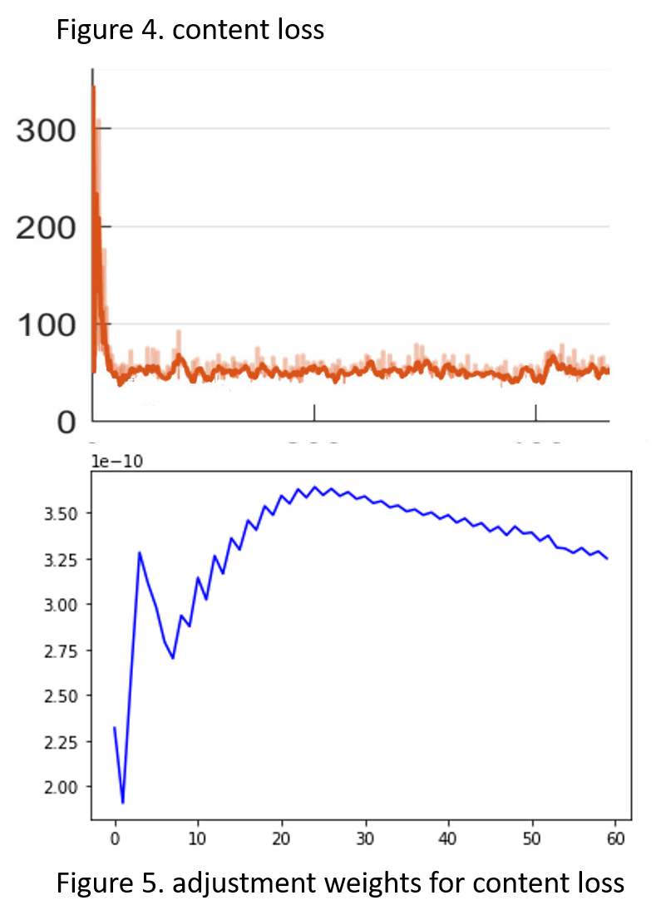
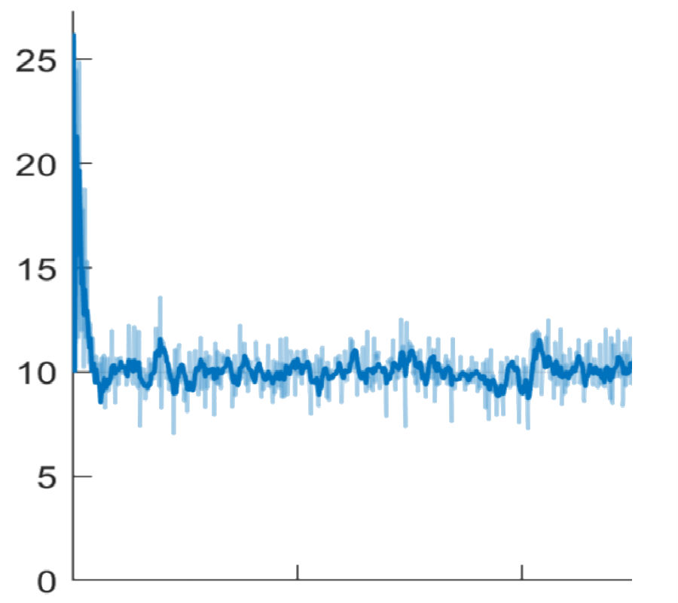
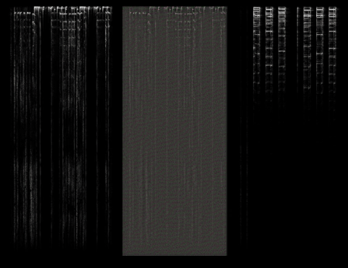
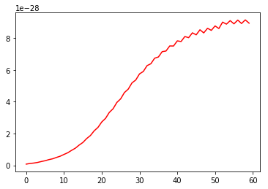
Optimizing process
Figure 6. style loss for 500 iterations
Figure 7. adjustment weights for style loss
Back

Slide 17
Result
content | style | mixed
Weight: 1.5 weight: 10.0

Slide 18
Discussion
Content weight | Style weight | Output
1.0 | 20.0
1.5 | 10.0
1.0 | 1.0
10.0 | 5.0
More
content
Less Style
next
Notes:
Adjust the weight of content and style

Slide 19
Thanks :)

